Slide 1
Chemistry Review: Organic Components—Carbohydrates and Proteins
Lecture 4

Slide 2
Objectives 1 of 2
Understand/know/focus on/note
the meaning of hydrolysis, condensation, polymer
chemical features of carbohydrates and names of a few monosaccharides: glucose and its isomers mannose, galactose
names of disaccharides and monosaccharides composing them: sucrose, lactose
glucose is stored as polymers: glycogen, starch
what makes these glucose polymers and that they are branched

Slide 3
Objectives 2 of 2
Understand/know/focus on/note
oligosaccharides (branched monosaccharide polymers) are attached to proteins and membrane lipids to make glycoproteins and glycolipds, respectively
basic atomic features of the amino acid
what peptide bonds are and how they are formed
the four levels of protein structure
the chemical bonding discussed previously applies to how proteins fold and amino acids bond with each other: H-bonding, ionic, hydrophobic
what enzymes are (catalysts made of protein) and the special structural features they have

Slide 4
Terms / Definitions / Descriptions
Hydrolysis ("cutting with water")
A chemical reaction in which H₂O is used in the bond breaking of a molecule into two distinct molecules, one taking an H atom and the other the OH atom
Condensation
in chemistry, it refers to the opposite of hydrolysis: joining two chemicals in a way that H₂O is released
both hydrolysis and condensation happen a lot in biochemistry
Polymer
A molecule made up of many repeating smaller molecules ("monomers") bonded together in a chemical reaction (polymerization). Polymeric forms of biochemicals are ubiquitous in biological organisms

Slide 5
Terms / Definitions / Descriptions
Isomer
A form of a molecule that can have many different structures while the number of the kinds of atoms is identical
C₂H₅O: diethyl ether is an isomer of ethanol

Slide 6
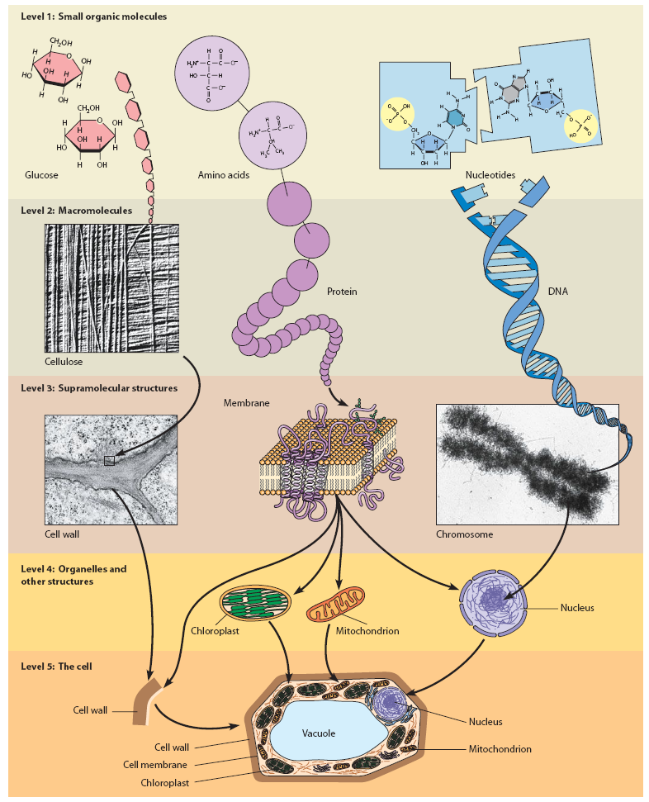
From molecular to cellular
polymerization of the small molecule monomer to a macromolecule
macromolecular assembly
supramolecular interaction to an organelle
Becker WotC p 28

Slide 7
Carbohydrates
Have the simple empirical formula CH₂O
1:2:1 C:H:O
Carbohydrates are "sugars"
polyhydroxy (poly –OH) aldehydes (aldoses)
aldehydes have this structure:
R groups are usually rest of molecule, where next bonded atom is C
polyhydroxy ketones (ketoses)
ketones have this structure:
Monosaccharides refer to the simplest molecules of carbohydrates that can be used to make up repeating chains (polymers)
Monosaccharide molecules range from 3-carbon molecules to 7-carbon sugar molecules

Slide 8
Glucose
Glucose is a 6-carbon monosaccharide (sugar) which is all-important in biology
C₆H₁₂O₆
Made in photosynthesis by leaves of plants
6 CO₂ + 6 H₂O + sunlight → C₆H₁₂O₆ + 6 O₂
Broken down in respiration by eukaryote cells to get energy/calories
C₆H₁₂O₆ + 6 O₂ → 6 CO₂ + 6 H₂O + energy (stored as ATP)

Slide 9

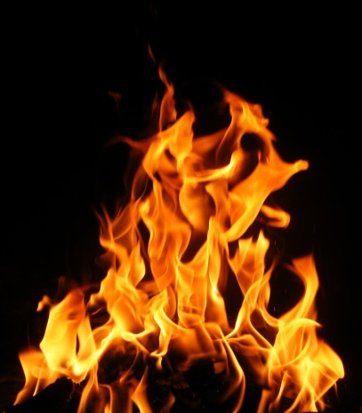
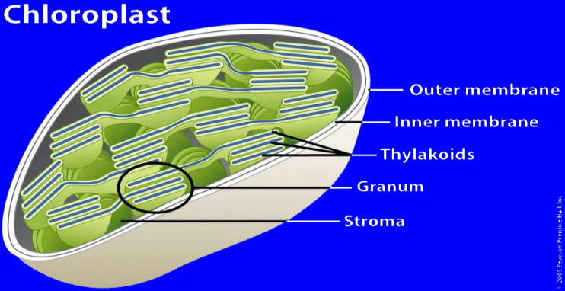
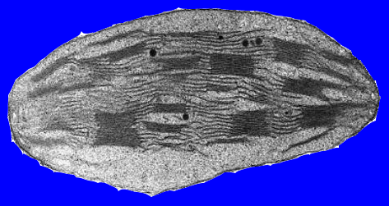
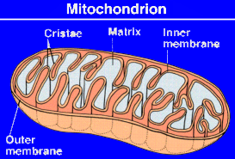
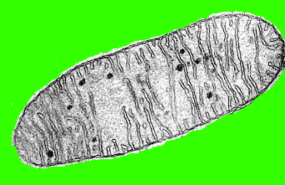
A Combined Carbon & Oxygen Cycle in Biology
photosynthesis
combustion
C₆H₁₂O₂
C_{n}H_{2n+2}
O₂
O₂
H₂O
CO₂
H₂O
O₂
Colored oxygen atoms show you how the "labeled" oxygen atoms move from molecule to molecule in the cycle
CO₂
C₆H₁₂O₂
respiration

Slide 10
Other Monosaccharides
The monosaccharides range in molecular size from the 3-carbon glyceraldehyde to 7-carbon heptuloses
Galactose combines with glucose to form the disaccharide lactose ("milk sugar")
Fructose combines with glucose to form the disaccharide sucrose (table sugar)
Monosaccharides can condense to form polymeric forms (polysaccharides)
In cells, mono- and polysaccharides occur in the ring form

Slide 11
Some Monosaccharide Structures
Galactose is a C-4 epimer of glucose
An epimer is an isomer in which two of the groups attached to a chiral carbon are switched stereochemically
Mannose is a C-2 epimer of glucose: it is particularly important in forming glycoprotein oligosaccharides
Fructose is a 2-keto isomer of glucose (ketohexose)
The 3-phospho form of glyceraldehyde is an intermediate in the most vital of metabolic pathways: glycolysis

Slide 12
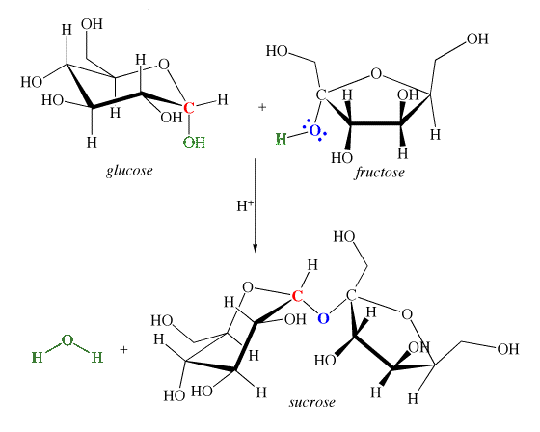
Forming Disaccharides
Two monosaccharides come together by a condensation reaction to form a glycosidic bond
Note the removal of H₂O to form the bond

Slide 13
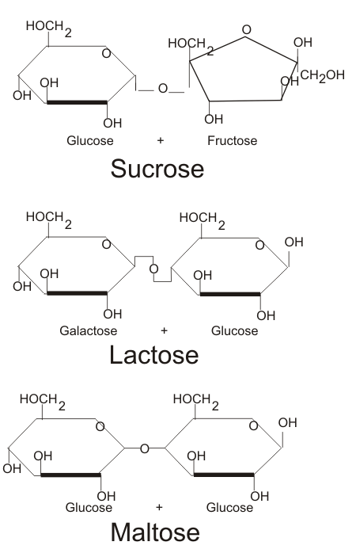
Disaccharides
Sucrose is the synthesis (condensation) of glucose + fructose
Lactose synthesizes galactose + glucose
Maltose is the synthesis two glucoses
Note that sucrose = glucose + fructose in that order
not fructose + glucose

Slide 14
Glucose As A Polymer
Glucose is how the cell gets the energy it needs to survive. It is transported in the blood as the monosaccharide and then imported into the cell
When glucose is not immediately utilized, it is stored as a polymer (polysaccharide)
The polymeric forms of glucose have different names, depending on what type of organism is making and storing them
glycogen: poly-glucose as a storage form in animals
starch: poly-glucose as a storage form in plants
digestible by animals
cellulose: poly-glucose used for cell walls by plants
not digestible by animals

Slide 15
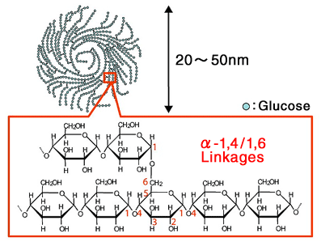
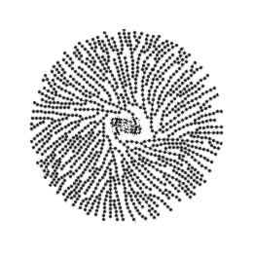
Glycogen
When glucose is not utilized in metabolism, it needs to be stored
In animals, the best storage form is glycogen
Glycogen is a highly branched polymeric form of glucose
Glycogen is stored in liver & skeletal muscle typically
the detail of the molecular structure of the linear polymer and its branch point, as well as the size of the molecule
image shows large molecule of glycogen
http://www.scientificpsychic.com/fitness/glycogen.gif
http://www.glico.co.jp/en/material/bioglycogen/image/top/img1a.gif

Slide 16
Starch
Starch is just like glycogen in that it is a polymer of glucose used as a storage form for glucose
Starch is a branched form of glucose polymer, although less branched than glycogen
Starch is the storage form for plants
Since animals consume plants, they have evolved a set of digestive (hydrolytic) enzymes that allow them to be able to break down starch into its separate monomers (monosaccharides) of glucose and use it

Slide 17
Cellulose
Cellulose is also a polymeric form of glucose (a polysaccharide)
But it is not a source of energy for most animals because animals do not have the enzymes to break cellulose down to its glucose monomers (monosaccharides)
When cows eat grass/hay/weeds, they get glucose from cellulose only because they have bacteria in one of their stomachs that have the enzymes to break it down, but many animals do not have those bacteria
Cellulose is what plants use to form the "skeletons" for their leaves, stems, roots, and flowers

Slide 18
Special Mention: Ribose & 2-Deoxyribose
Ribose is a 5-carbon sugar (aldose)
Ribose is used in the backbone of RNA
Its 2-deoxyribose form is used in the backbone of DNA
This yellow background information box is shown for your information, and is not required to be memorized for assessment purposes

Slide 19
Polysaccharide Significance
Polysaccharides are important for a variety of functions other than being a storage form for glucose
In plants they form much of the cell wall that is part of the skeleton for the plant (cellulose + lignin)
Arthropods bodies (exoskeletons) are formed from polysaccharides (chitin)
Animal cartilage is a polysaccharide matrix (hyalouronic acid)

Slide 20
Glycoproteins
Oligosaccharides are attached to polypeptides to form glycoproteins
There are N- and O-glycoproteins, which indicate the amino acid side chain atom to which the oligosaccharide is attached
N-glycoproteins attach to the –NH2 group of the amino acid asparagine (Asn)
O-glycoproteins attach to the –OH group of the hydroxyl amino acids serine (Ser) and threonine (Thr)
Purposes of glycosylating proteins
required for particular folding
resist degradation, particularly when protein exported
indicate destination for the glycoprotein location

Slide 21
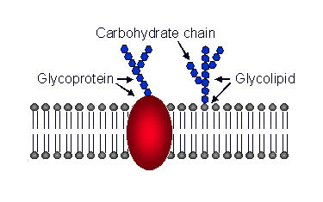
Glycolipids
Oligosaccharides are attached to lipids particularly those that form the cell membrane
Glycolipids are particularly important for a cell identifying itself to another cell (cell-cell recognition)
They can also be utilized in metabolism to produce energy
https://animalcellbiology.files.wordpress.com/2011/08/membrane-lipids-and-proteins.gif?w=460

Slide 22
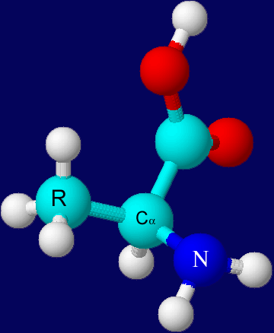
The Amino Acid
Has four basic parts in the chemical structure
The "central" alpha-carbon
this carbon is "chiral," meaning it is bonded to 4 different groups and thus has stereochemistry
The amino (–NH₂) group
this group will bond with the –COOH group to form the peptide bond
The carboxyl (–COOH) group
this group will bond with the –NH₂ group to form the peptide bond
The side ("R") group/chain
this has 20 different possible groupings of atoms
The amino acid L-alanine in 3D (R-configuration)

Slide 23
The Natural Amino Acids
There are 20 natural amino acids in eukaryotes
The side chain of the amino acid gives it its special chemistry and name
Because amino acids make up the sequences of polypeptides, biologists/biochemists have created special 1- and 3-letter abbreviations used when discussing proteins
The chemistry of the side chain allows amino acids to be classed differently
ionic/electrostatic
polar
non-polar, hydrophobic

Slide 24
The Amino Acid
 | 3-letter abbr. |  | 1-letter abbr. | MW | Side-chain structure | pK_{a}
Non-polar Amino Acids
Alanine |  | Ala | A | 89.1 |  | 2.35 | α-COOH
 |  |  |  |  |  | 9.69 | α-NH₂
Valine |  | Val | V | 117.1 |  | 2.32 | α-COOH
 |  |  |  |  |  | 9.62 | α-NH₂
Leucine |  | Leu | L | 131.2 |  | 2.36 | α-COOH
 |  |  |  |  |  | 9.6 | α-NH₂
Isoleucine |  | Ile | I | 131.2 |  | 2.36 | α-COOH
 |  |  |  |  |  | 9.68 | α-NH₂
Phenylalanine |  | Phe | F | 165.2 |  | 1.83 | α-COOH
 |  |  |  |  |  | 9.13 | α-NH₂
Tryptophan |  | Trp | W | 204.2 |  | 2.38 | α-COOH
 |  |  |  |  |  | 9.39 | α-NH₂
Methionine |  | Met | M | 149.2 |  | 2.28 | α-COOH
 |  |  |  |  |  | 9.21 | α-NH₂
Proline |  | Pro | P | 115.1 |  | 1.99 | α-COOH
 |  |  |  |  |  | 10.6 | α-NH-

Slide 25
The Amino Acid
 | 3-letter abbr. |  | 1-letter abbr. | MW | Side-chain structure | pK_{a}
Polar Amino Acids
Glycine |  | Gly | G | 75.1 |  |  | 2.34 | α-COOH
 |  |  |  |  |  |  | 9.6 | α-NH₂
Serine |  | Ser | S | 105.1 |  |  | 2.21 | α-COOH
 |  |  |  |  |  |  | 9.15 | α-NH₂
Threonine |  | Thr | T | 119.1 |  |  | 2.63 | α-COOH
 |  |  |  |  |  |  | 9.15 | α-NH₂
Cysteine |  | Cys | C | 121.2 |  |  | 1.71 | α-COOH
 |  |  |  |  |  |  | 8.33 | side chain
 |  |  |  |  |  |  | 10.78 | α-NH₂
Tyrosine |  | Tyr | Y | 181.2 |  |  | 2.2 | α-COOH
 |  |  |  |  |  |  | 9.11 | α-NH₂
Asparagine |  | Asn | N | 132.1 |  |  | 2.02 | α-COOH
 |  |  |  |  |  |  | 8.8 | α-NH₂
Glutamine |  | Gln | Q | 146.1 |  |  | 2.17 | α-COOH
 |  |  |  |  |  |  | 9.13 | α-NH₂

Slide 26
The Amino Acid
 | 3-letter abbr. |  | 1-letter abbr. | MW | Side-chain structure | pK_{a}
Ionic Amino Acids
Aspartic Acid |  | Asp | D | 133.1 |  |  | 2.09 | α-COOH
 |  |  |  |  |  |  | 3.86 | side chain
 |  |  |  |  |  |  | 9.82 | α-NH₂
Glutamic Acid |  | Glu | E | 147.2 |  |  | 2.19 | α-COOH
 |  |  |  |  |  |  | 4.25 | side chain
 |  |  |  |  |  |  | 9.67 | α-NH₂
Lysine |  | Lys | K | 146.2 |  |  | 2.18 | α-COOH
 |  |  |  |  |  |  | 10.53 | side chain
 |  |  |  |  |  |  | 8.95 | α-NH₂
Arginine |  | Arg | R | 174.2 |  |  | 2.17 | α-COOH
 |  |  |  |  |  |  | 12.48 | side chain
 |  |  |  |  |  |  | 9.04 | α-NH₂
Histidine |  | His | H | 155.2 |  |  | 1.82 | α-COOH
 |  |  |  |  |  |  | 6.00 | side chain
 |  |  |  |  |  |  | 9.17 | α-NH₂

Slide 27
Chemical Bonding In The Polypeptide
Ionic (Electrostatic)
Ser
Glu
H-bonding
Cys
Ile
Asn
Cys
Covalent (disulfide)
Lys
Hydrophobic
Leu

Slide 28
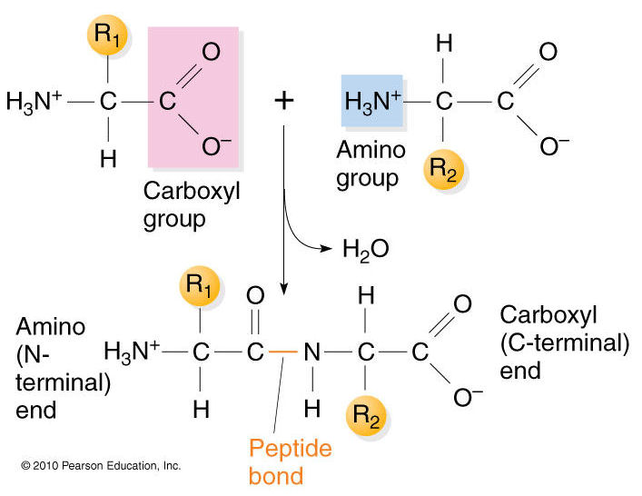
The Peptide Bond
The peptide bond is the name of the link that describes the amino acid polymer (polypeptide)
Chemically it is an amide (covalent) bond
It forms as a result of the condensation between the –COOH group of one amino acid (N) and the –NH₂ group of the next amino acid (N+1)
Note the loss of H₂O in forming the bond The details of how the cell actually produces the peptide bond will be discussed later in the protein synthesis lecture

Slide 29
Polypeptides
Polypeptides are the single molecule that represents the polymer of amino acids
They have a directionality
an amino terminus
also often written as N-terminus or NH₂-terminus
a carboxyl terminus
also often written as C-terminus or COOH-terminus
usually sequences are written left to right where the left end is the N-terminus and the right is the C-terminus
Polypeptides are synthesized from the N-terminus to the C-terminus as well

Slide 30
Protein Structure
Proteins have four levels of structure
Primary (1°)
Secondary (2°)
Tertiary (3°)
Quaternary (4°)

Slide 31
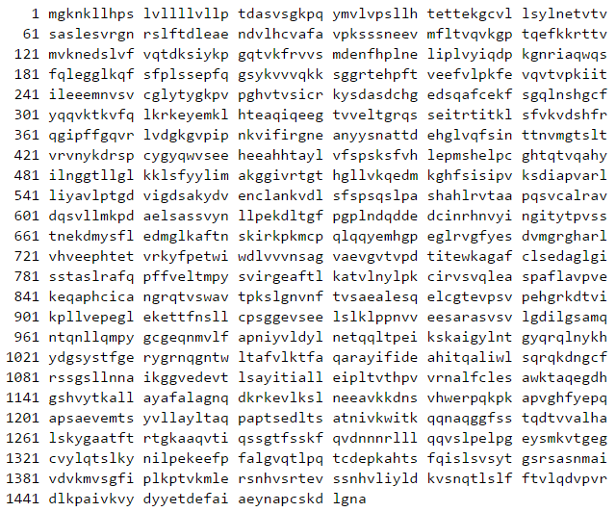
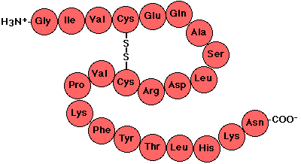
Primary Structure of Proteins
This is the amino acid sequence itself
The amino acids and the order they appear have most, if not all, the information to direct the folding of the polypeptide to its higher levels of structure
the amino acid sequence of α₂-macroglobulin shown with its 1-letter abbreviations
amino acids of a short peptide shown with their 3-letter abbreviations

Slide 32
Secondary Structure of Proteins
These are special structural formations of the polypeptide that are created by atoms in the backbone of the polymer (polypeptide) forming hydrogen bonds with other atoms in the backbone
alpha (α) helix
the polypeptide forms a helical twist using the atoms in the "backbone," which form hydrogen bonds (H-bonds) with each other
beta (β) sheet
the polypeptide forms long linear tracks with atoms in the "backbone," which form H-bonds in a way that forms a flat sheet; the polypeptide also forms loops or turns at the end so that it can do this; when the backbone has the same N→C directionality, they form parallel sheets, whereas if the directionality is opposing, they form less-strained antiparallel sheets

Slide 33
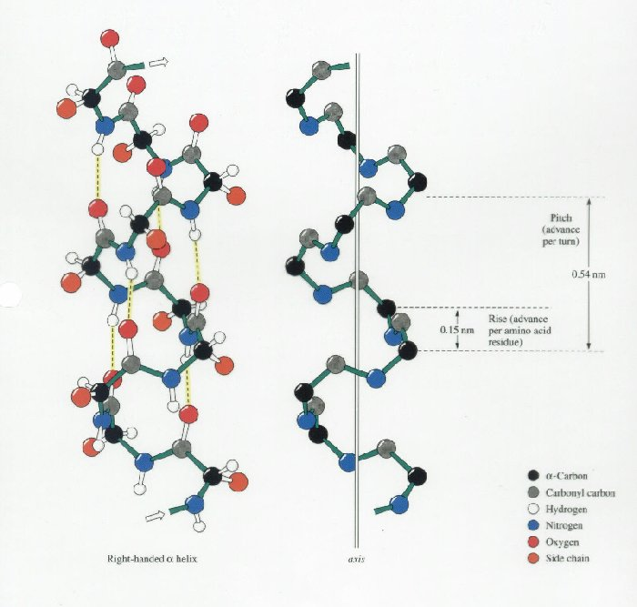
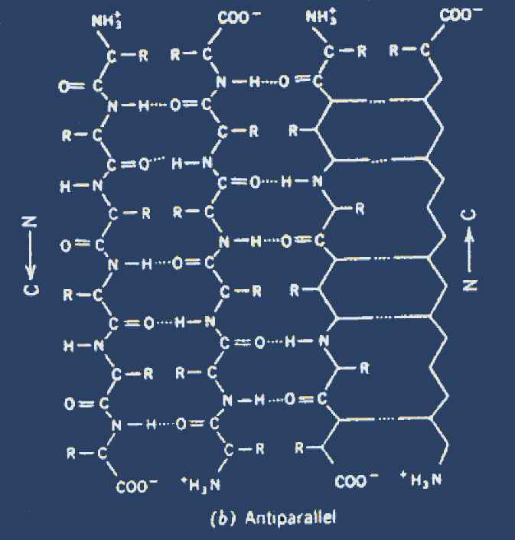
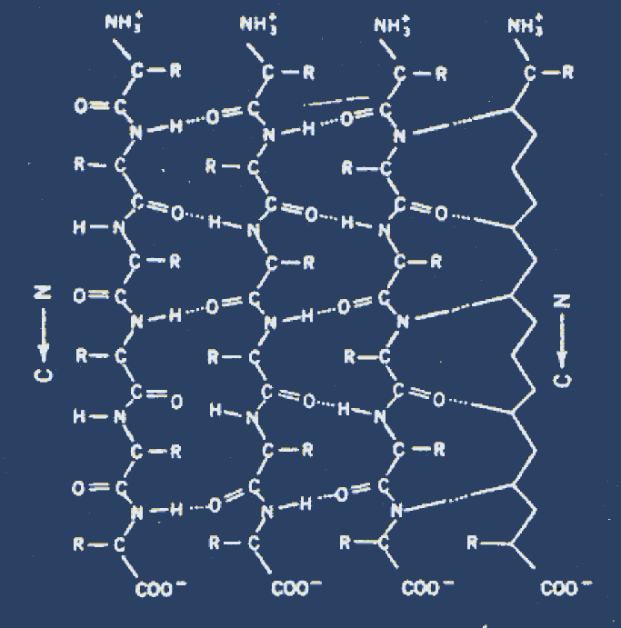
2° Structures
α-helix β-sheet
anti-parallel parallel
Expected learning: you should know that polypeptides have secondary structure and that this is alpha helix and beta sheet, and that atoms of the backbone form them by hydrogen bonding. You do not need to know the two forms of beta sheet or be able to diagram their chemical structures.
http://web.campbell.edu/faculty/nemecz/323_lect/proteins/images/alpha_helix.jpg

Slide 34
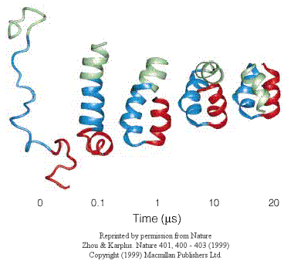
Tertiary Structure of Proteins
Tertiary (3°) structure is created by a number of bond/interaction types (ionic, hydrophobic, H-bond, even covalent) that cause the polypeptide to fold, coil, curl, etc. The 2° α-helices and β-sheets are preserved
In the figure at right, molecular dynamics computations are used to show the formation of the tertiary structure of the villin polypeptide.
For a half century, scientists have been working on predicting 3° structure (folding) from 1° structure (the amino acid sequence)

Slide 35
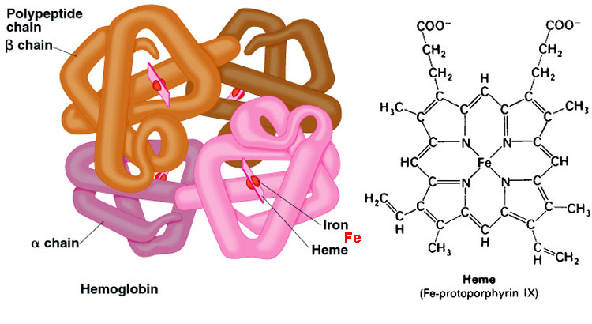
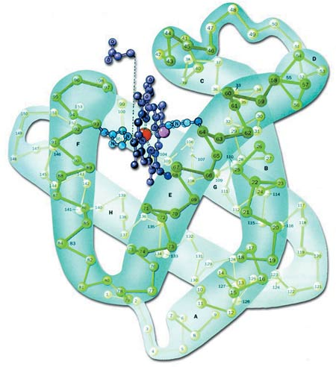
Quaternary Structure of Proteins
After the polypeptide completes its three levels of structure, it may associate with other polypeptides that are identical to it or different from it
These are multi-subunit proteins: that is, polypeptides that associate with identical or different polypeptides have 4° structure
Hemoglobin (Hb) has 4° structure: two α and two β subunits, each binding a heme group that coordinates Fe²⁺
Myoglobin (Mb) [lower right] is an oxygen (O₂)-binding protein like Hb with Fe²⁺-heme group but has no quaternary structure
https://aberdeenc.files.wordpress.com/2013/02/hemoglobin.jpg

Slide 36
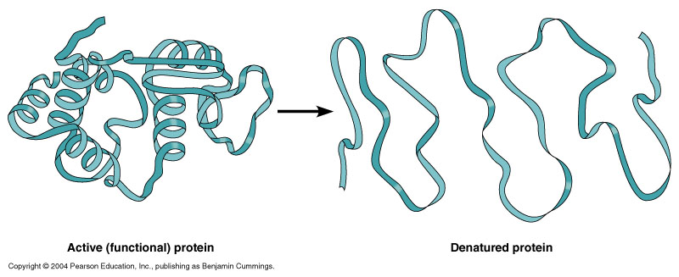
The Complete Protein
Remember, the protein represents a single functional entity
It might be composed of a single polypeptide or it might be composed of multiple subunits
It also may be composed of other ions and/or molecules that are not proteinaceous (amino acid oligo- or polymers), such as metal cation cofactors or coenzymes
Proteins must be folded into their "native" functional, active structure to work (see figure)
When heated in boiling water for just a few minutes, proteins unfold into a "denatured" form that may not reform to the active
when you cook eggs, the formation of the whites is protein denaturation
http://classes.midlandstech.com/carterp/Courses/bio225/chap05/05-06_Denaturation_1.jpg

Slide 37
Various Functions (Purposes) of Proteins
Enzymes
Structural Proteins
Membrane Proteins
receptors
channels
transporters
exchangers

Slide 38
Enzymes
Catalyze (perform) biochemical reactions
Essential proteins in every metabolic pathway
biosynthesis
catabolism
As catalysts, they lower the activation enegy of the reaction
Enzymes bind substrates (the reactants)
Enzymes provide the products

Slide 39
Enzyme Structure
Substrate-binding site(s)
The amino acids that are involved with positioning the substrates in the enzyme for catalysis
Active site
This is the catalytic center, where the reaction takes place
The amino acids that are involved in the reaction form the active site
Regulatory sites
Inhibitory: the amino acids that bind metabolites to stop or reduce the rate of enzyme's activity (negative feedback)
Activating: the amino acids that bind metabolites that increase the rate of enzyme's activity (positive feedback)
Enzyme kinetics studies the rates of catalysis, the concentrations of all components, and the regulation by inhibitors and activators

Slide 40
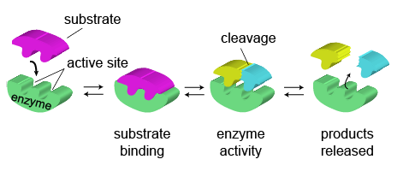
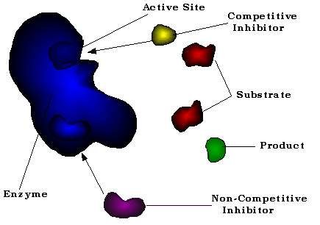
http://media1.shmoop.com/images/biology/biobook_flow_5a.png
http://web.fscj.edu/David.Byres/inhibitors.gif

Slide 41
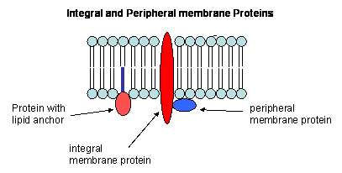
Membrane Proteins
Proteins attached to ("peripheral") or embedded in ("integral") the cell membranes
Integral membrane proteins that span the membrane include many types
Receptors
Transporters + Exchangers
Channels
We'll talk about these protein types later

Slide 42
Reading (Sources)
Marieb: Chapter 2, pp 43-45, 49-53
Becker's WotC: pp 41-53, 60-65
Raven: Chapter 3.2, 3.4

